Slide 1


Slide 3
Outline
Electrical Machine Drives
Inverters
Aim of the Study
Inverter Control Techniques
3- Level NPC Inverters & Drive Methods
Possible Fault States
Operation Vector Under Fault States
Conclusion

Slide 4

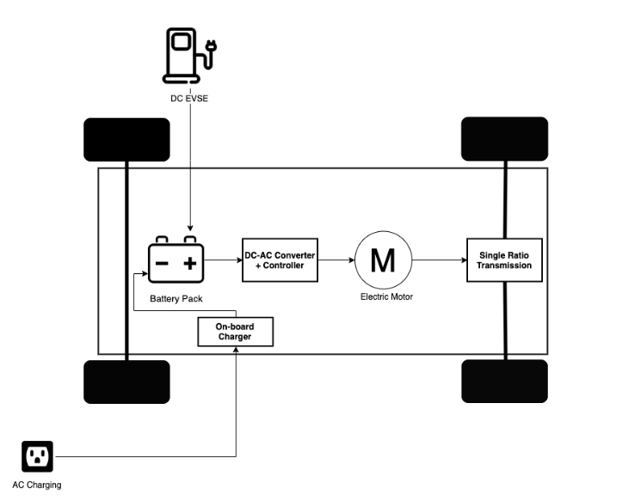
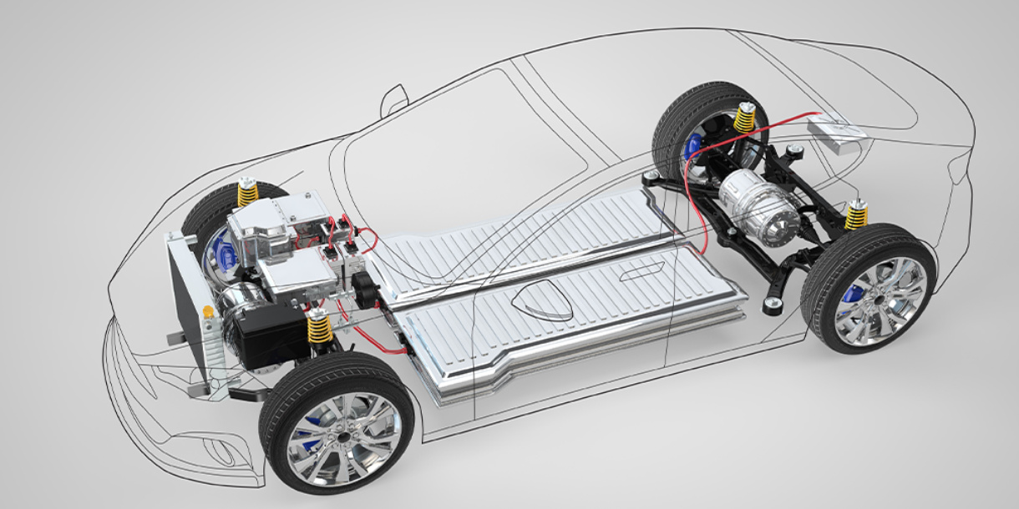
Electrical Machine Drives
AC Machine Applications,
Electrical Vehicles
Renewable Energy Systems
Control of an AC Machine for
desired Speed, Torque
DC/AC Converters (Inverters)

Slide 5
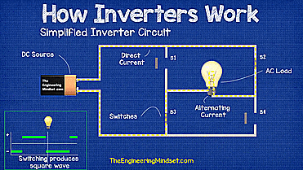
Inverters
DC voltage to AC voltage
Opening and closing the switches with different times
Square wave output voltage
Sinusoidal PWM Output Phase Voltages¹
¹ https://theengineeringmindset.com/how-inverters-work/

Slide 6
Inverters
2-level Inverters
3-Level NPC Inverters
[Vdc/2, -Vdc/2] voltage levels
6 switches
Voltage stress of switch: Vdc
[Vdc/2, 0, -Vdc/2] voltage levels
12 switches, 6 diodes
Voltage stress of switch: Vdc/2
2-Level Inverter Circuit
3-Level NPC Inverter Circuit

Slide 7
Aim of the Study
800V 10 kW AC Motor Drives with 3-Level NPC Inverter
Control Methods Abilities of the Inverter
Observing Fault Situation Behavior of Inverter
Fault Tolerant Operations of 3-level NPC Inverters

Slide 8
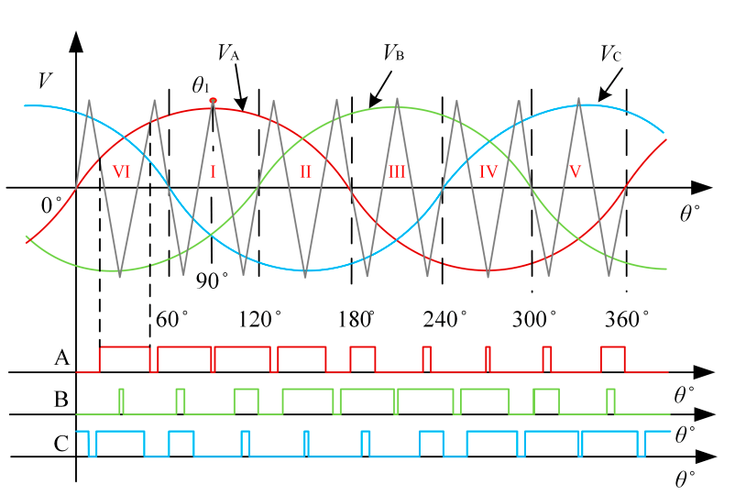
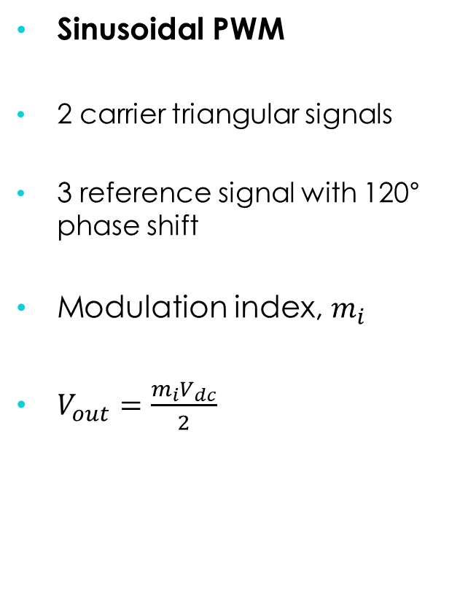
Inverter Control Techniques
Sinusoidal PWM
2 carrier triangular signals
3 reference signal with 120° phase shift
Modulation index, $m_{i}$
$V_{out}=\frac{m_{i}V_{dc}}{2}$
Sinusoidal PWM Output Phase Voltages

Slide 9
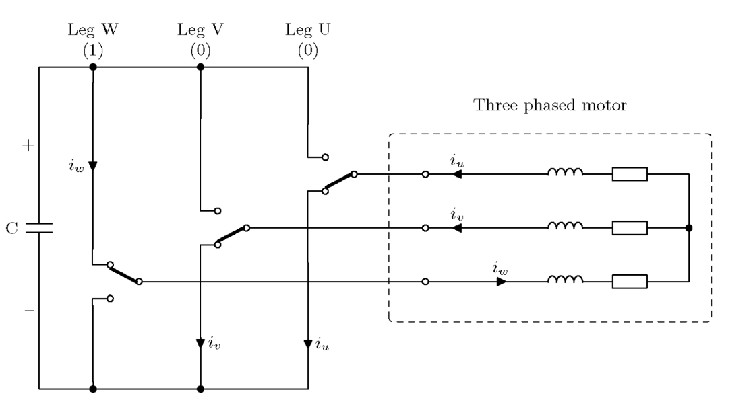
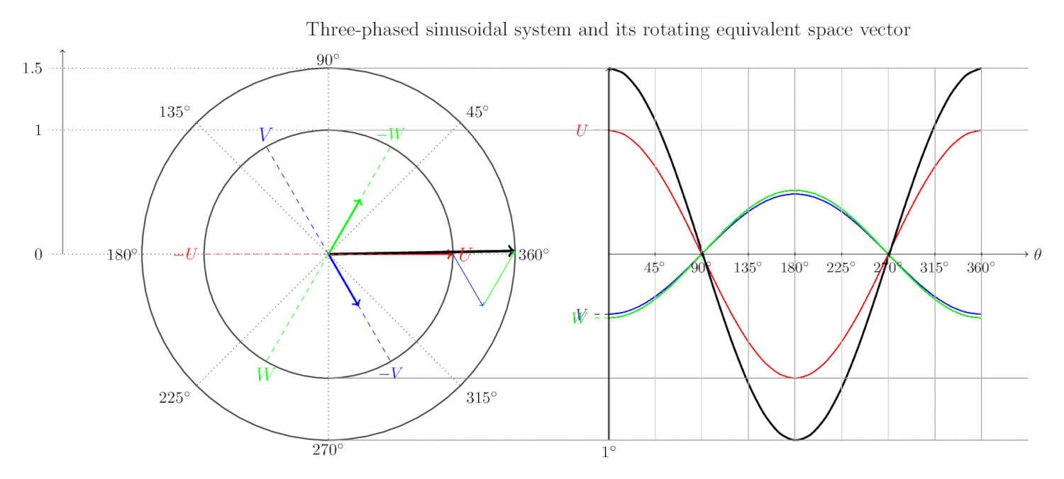
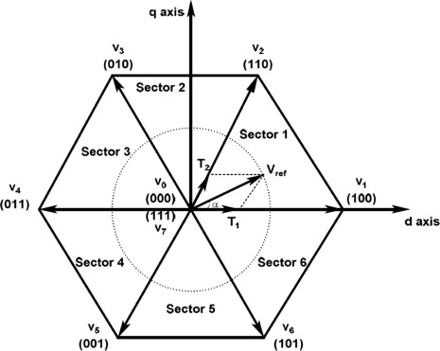
Inverter Control Techniques
Space Vector PWM (SVPWM)
Rotating frame to Stationary frame
Equivalent vector defined sum of three vector.
Clark & Park Transformations
2-Level Inverter Vector Diagram

Slide 10
3- Level NPC Inverters & Drive Methods
12 switches & 6 diodes to obtain P, O, N states.
State | Vout | Q1 | Q2 | Q3 | Q4
P | +Vdc/2 | ON | ON | OFF | OFF
O | 0 | OFF | ON | ON | OFF
N | -Vdc/2 | OFF | OFF | ON | ON
Switch States of 3-Level Inverter
3-Level NPC Inverter Circuit

Slide 11
Control Techniques
Space Vector PWM (SVPWM) for 3-Level NPC Inverter
Totally 27 pace vectors
Required output vector is obtained by using four vectors.
Reference vectors can also be manipulated with small vectors.
[PPP], [OOO], [NNN]: zero vectors
Space Vector Diagram of 3-Level NPC Inverter

Slide 12
Possible Fault Scenarios
Short Circuit
Open Circuit
Overcurrent condition
Current distortion observed significantly.
Chance to operate with limited conditions
Effect of fault of middle switches is larger
3-Level NPC Inverter Circuit

Slide 13
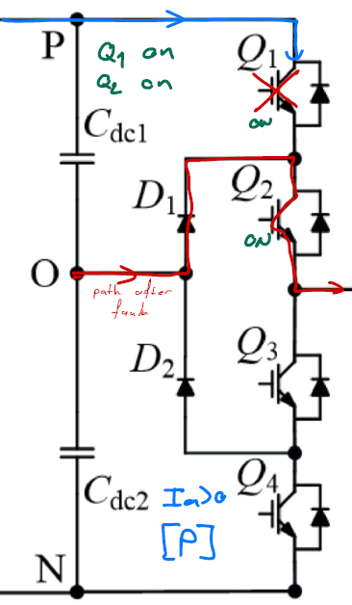
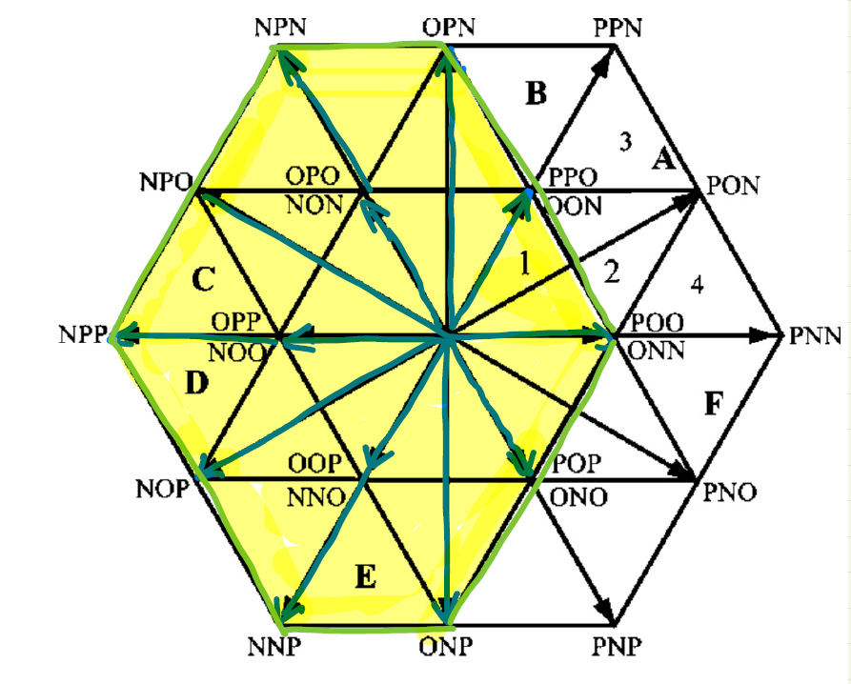
Space Vectors Under Fault States
Q1
Open Circuit
Current flow of phase-a when Ia>0 and at P-state
Space Vector Diagram for Q1 fault

Slide 14
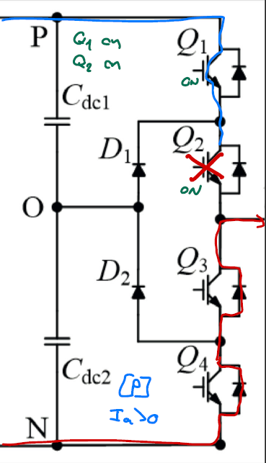
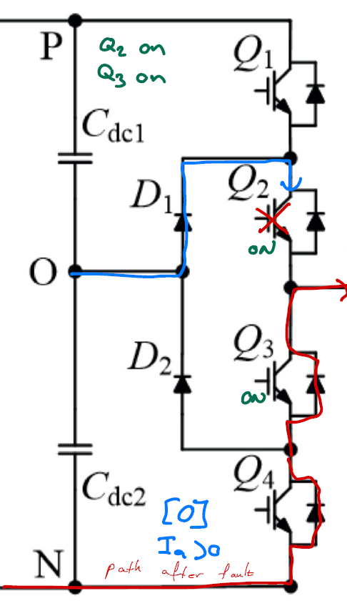
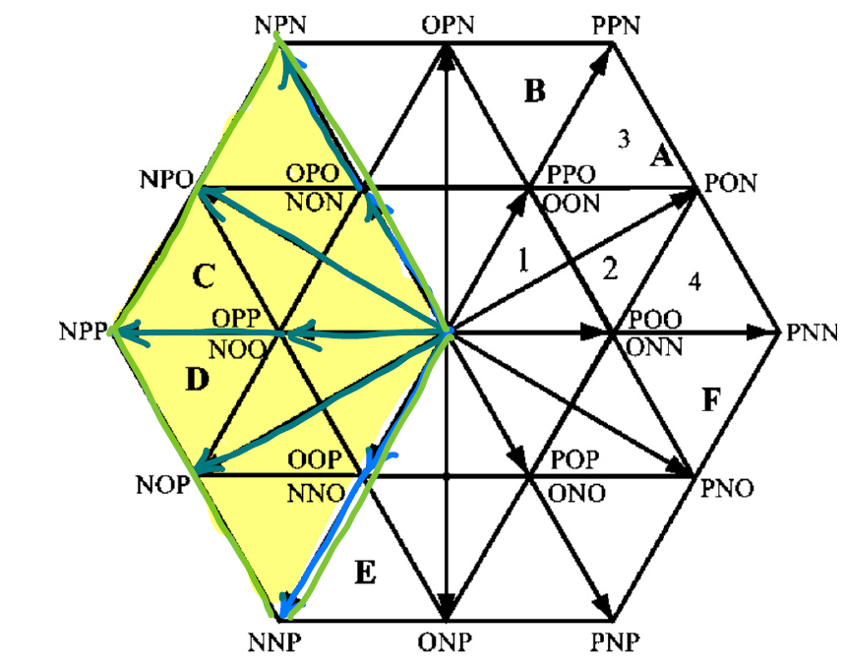
Space Vectors Under Fault States
Q2
Open Circuit
Q2
Open Circuit
Current flow of phase-a when Ia>0 and at
P-state
Current flow of phase-a when Ia>0 and at
O-state
Space Vector Diagram for Q2 fault

Slide 15
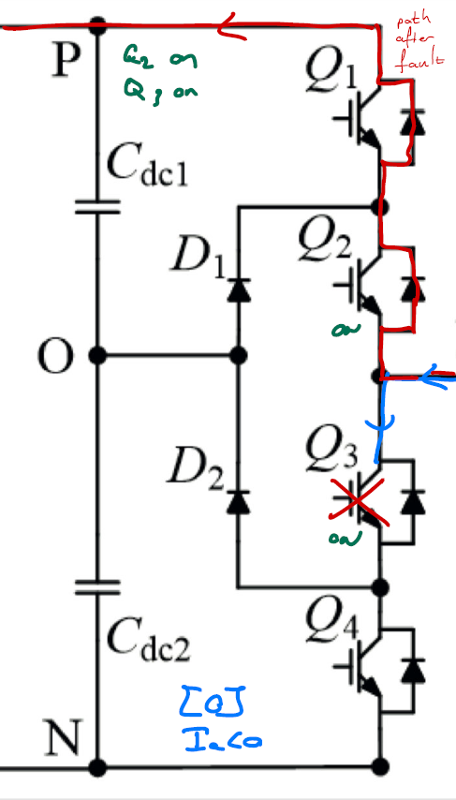
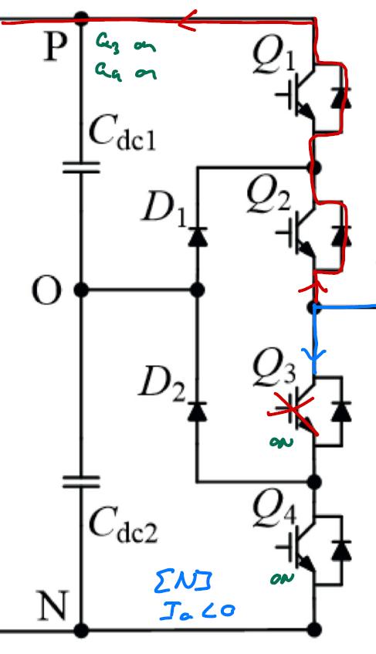
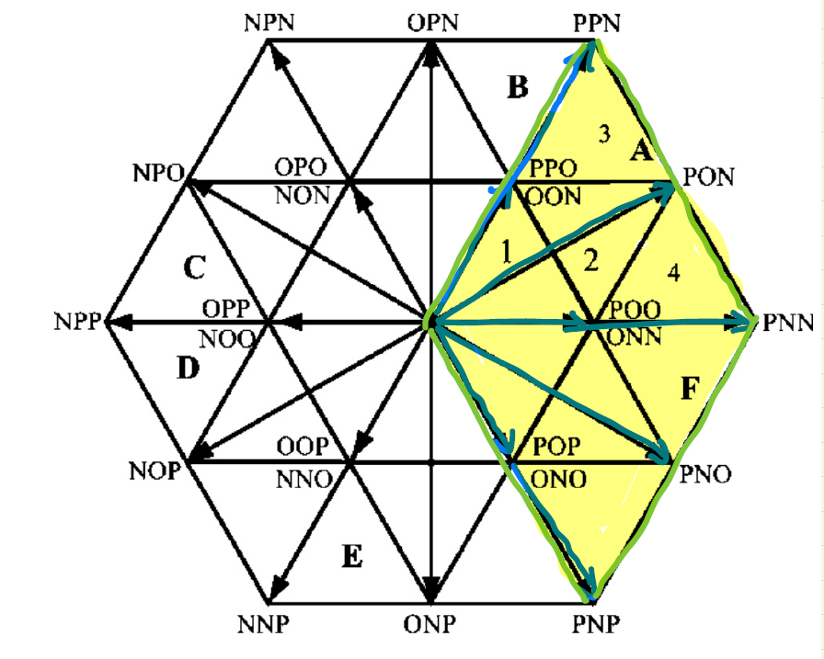
Space Vectors Under Fault States
Q3
Open Circuit
Q3
Open Circuit
Space Vector Diagram for Q3 fault
Current flow of phase-a when Ia<0 and at
O-state
Current flow of phase-a when Ia<0 and at
N-state

Slide 16
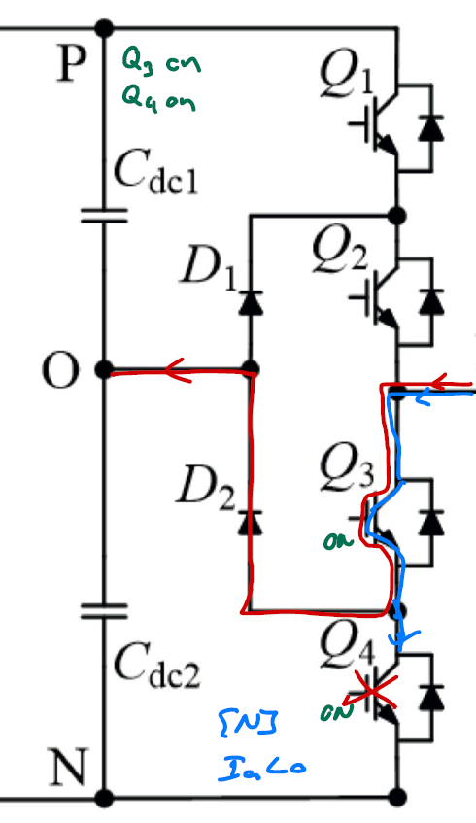
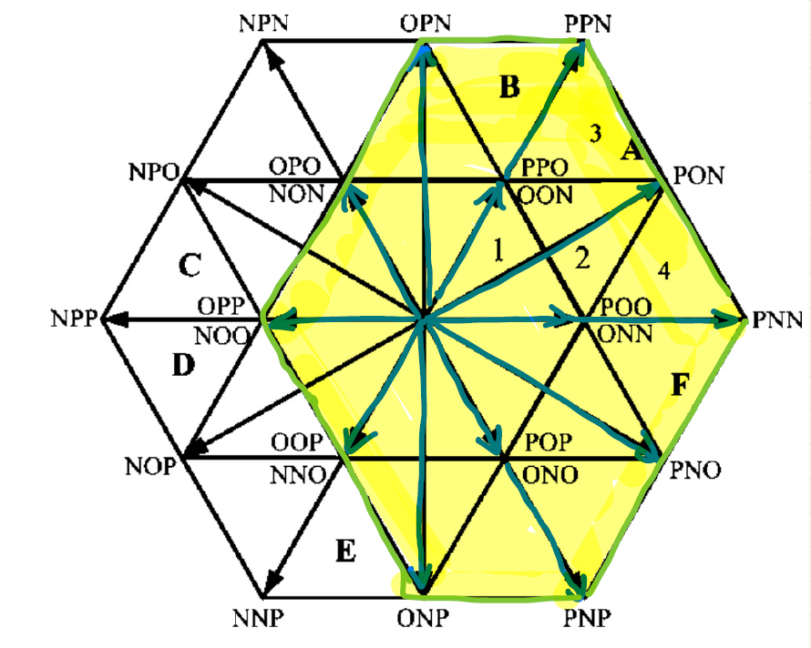
Space Vectors Under Fault States
Q4
Open Circuit
Space Vector Diagram for Q4 fault

Slide 17
Conclusion
3-Level NPC Inverters are efficient inverter solutions for High Voltage AC Machines.
Open circuit fault is tolerable
Fault in 1st and 4th switches can be tolerable with limited conditions.

Slide 18
Reference
[1] J. Rodriguez, S. Bernet, P. K. Steimer and I. E. Lizama, "A Survey on Neutral-Point-Clamped Inverters," in IEEE Transactions on Industrial Electronics, vol. 57, no. 7, pp. 2219-2230, July 2010
[2] Keqing Qu, Xi Jin, Yuehong Xing, Zuojin Ding and W. Chen, "A SVPWM control strategy for NPC three-level inverter," 2011 IEEE Power Engineering and Automation Conference, Wuhan, China, 2011
[3] K. Patel, S. Borole, R. Manikandan and R. R. Singh, "Short Circuit and Open Circuit Fault Identification Strategy for 3-Level Neutral Point Clamped Inverter," 2021 Innovations in Power and Advanced Computing Technologies (i-PACT), Kuala Lumpur, Malaysia, 2021
[4] A. Alili, A. A. Ameri, M. B. Camara and B. Dakyo, "Open-circuit fault detection method for Grid-side Three-level NPC Inverter," 2021 10th International Conference on Renewable Energy Research and Application (ICRERA), Istanbul, Turkey, 2021
[5] K. Yamanaka, A. M. Hava, H. Kirino, Y. Tanaka, N. Koga and T. Kume, "A novel neutral point potential stabilization technique using the information of output current polarities and voltage vector," in IEEE Transactions on Industry Applications, vol. 38, no. 6, pp. 1572-1580, Nov.-Dec. 2002
[6] A. Benevieri, L. Carbone, S. Cosso, F. Gallione and S. Hussain, "A New Strategy for Detection and Management of Faults in High Power NPC Converter Systems," 2023 13th International Symposium on Advanced Topics in Electrical Engineering (ATEE), Bucharest, Romania, 2023

